Slide 1
IIR FILTER

Slide 2
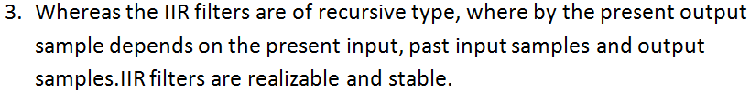
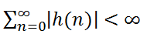
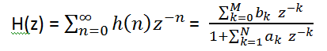

Slide 3

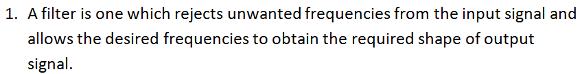


Slide 4

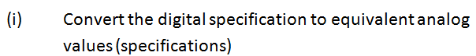

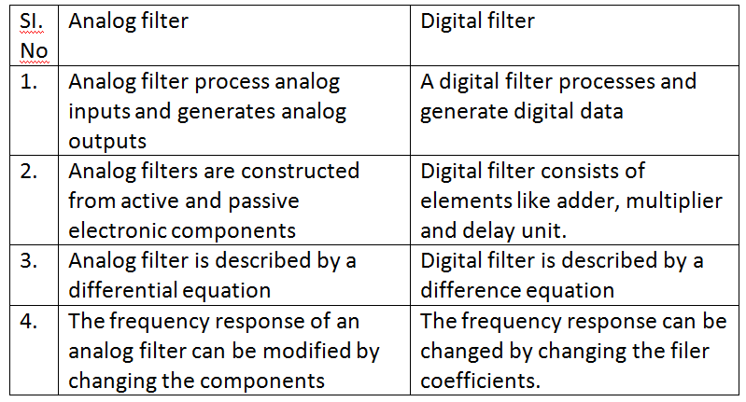

Slide 5

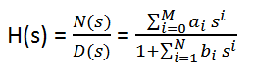
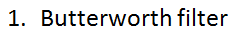

Slide 6

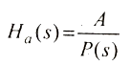
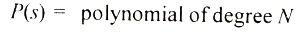
------------------(1)

Slide 7
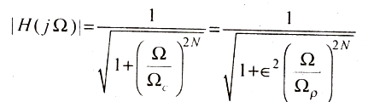
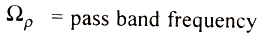
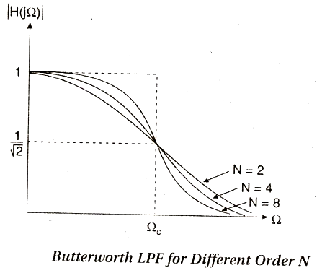
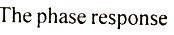
------------------(2)

Slide 8
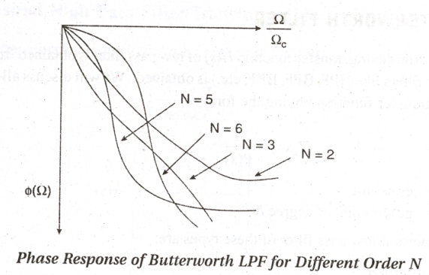
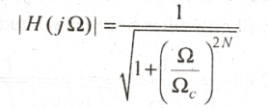
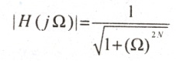

Slide 9
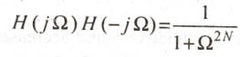
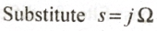
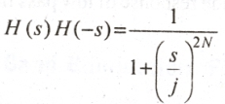
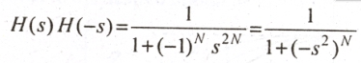
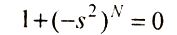
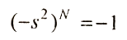
------------------(5)
S^2N = 1= e^j2π k (or) Sk = e^j2πk/2N for k= 1,2…2N
For N= even, ex for N=2, s^4= -1, Sk = e^j(2k-1)π and for N=odd, Sk= e^jπk/N

Slide 10
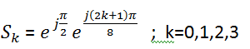
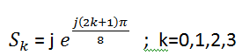
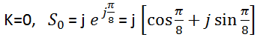
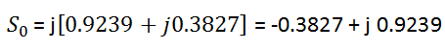
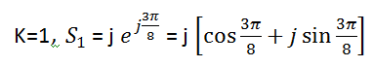
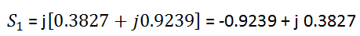

Slide 11
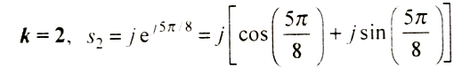
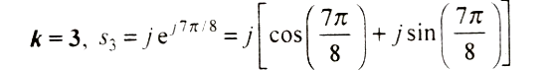
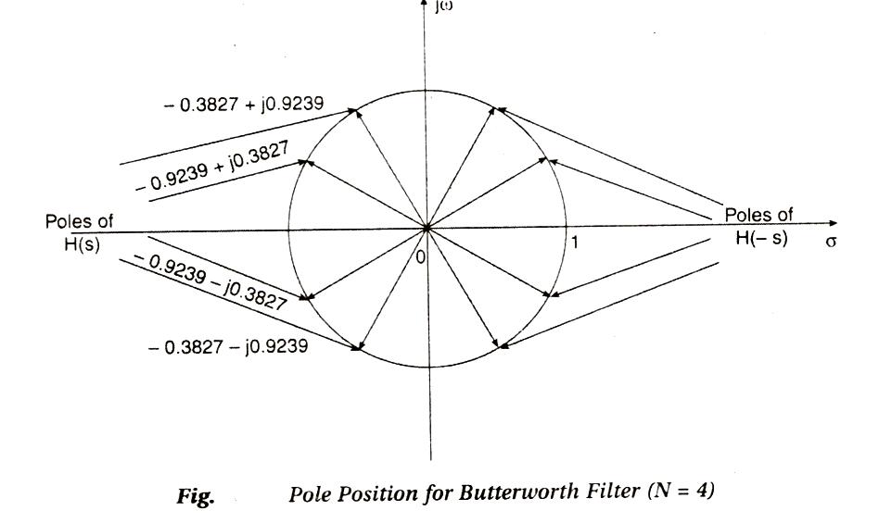

Slide 12
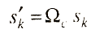

(7)

Slide 13
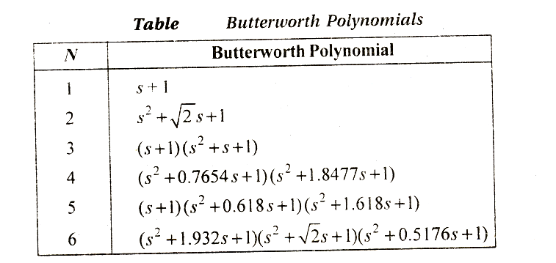

Slide 14
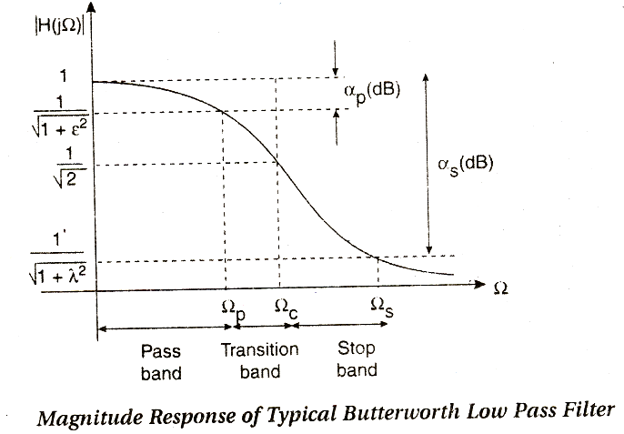
(2)

Slide 15
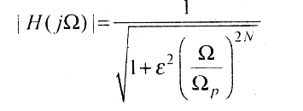
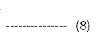
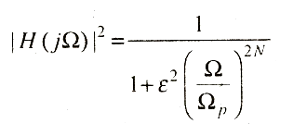
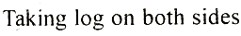
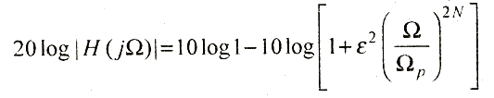
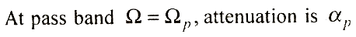
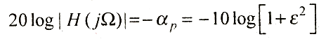
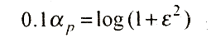
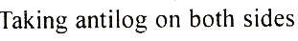
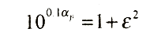

Slide 16
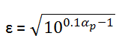
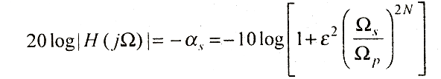
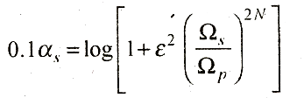
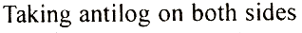
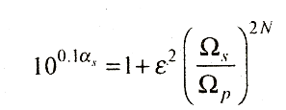



Slide 17






(13)

Slide 18




the equn (14) can be simplified as

Slide 19




Following methods are used to convert analog filter into digital filter

Slide 20






Slide 21








problem

Slide 22








Slide 23










therefore

Slide 24






Applying partial fraction method

Slide 25







Slide 26


Slide 27







Slide 28








Slide 29









Slide 30






Comparing eqn (a) and (5)
Characteristics of bilinear transformation
W.K.T

Slide 31







-------------------(7)

Slide 32




From equn (7)
left side of s plane is mapped to inside of unit circle in Z plane
and right side of s plane is mapped into outside of the unit circle in Z plane

Slide 33









Slide 34



bilinear transformation, using the formula

Slide 35





Slide 36







problem

Slide 37



Slide 38


STEPS FOR DESIGN OF BUTTERWORTH FILTER

Slide 39








here

Slide 40





Slide 41






Slide 42



Slide 43









Find Ω

Slide 44






Find N
Find transfer function of normalized LPF H(s)
(Refer table)

Slide 45






Find denormalised transfer function
In H(s)

Slide 46






Slide 47








Slide 48






The transfer function for II order filter

Slide 49







To find roots , denominator term equal to =0
S²+ 1465.78 S + 1072.25Х10³ = 0

Slide 50









To get H(s) =
Form Apply partial fraction method

Slide 51






There fore
We know

Slide 52






Slide 53











Slide 54






Slide 55










Slide 56







Slide 57










problem

Slide 58






Slide 59






Slide 60







Slide 61







Slide 62








Slide 63






Slide 64







Slide 65








problem

Slide 66







Approximating to nearest higher value we have N=2
For N=2

Slide 67








Slide 68







Slide 69









Slide 70






Slide 71










Slide 72
IIR SYSTEM REALIZATION IN (I) DIRECT FORM I (II) DIRECTFORM II (III) CASCADE FORM (IV) PARALLEL FORM

Slide 73



Slide 74


Slide 76




Slide 77


Slide 78





Slide 79







Slide 80







Slide 81






Slide 82






Slide 83






Slide 84








Slide 85






Slide 86






Slide 87







Slide 88








Slide 89





Slide 90



Slide 91









Slide 92





Slide 93



Slide 94









Slide 95






Slide 96




Slide 97





Slide 98






Slide 99







Slide 100








Slide 101




Slide 102


Slide 103


Slide 104








Slide 105







Slide 106





Slide 107






Slide 108




